Slide 1
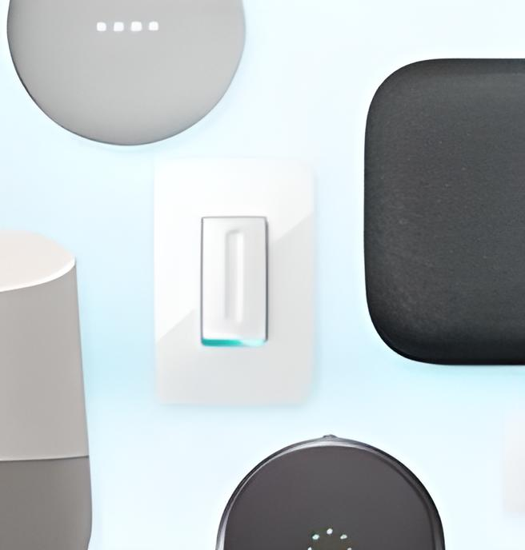

Bellabeat's Case
Study: Analyzing
Smart Device
Usage Data
We explore how non-Bellabeat smart
devices are being used and how we can
apply these insights to Bella beat's products.
by Aritra Basu
19-04-2023

Slide 2

Business Questions
What are some trends in smart device usage?
How could these trends apply to Bellabeat customers?
How could these trends help influence Bellabeat marketing strategy?

Slide 3

Outline
Executive Summary
Introduction
Methodology
Visualizations
Dashboards
Charts
Findings
Conclusion
Appendix

Slide 4

Executive Summary
Goal of the analysis
Methodology Description
Capturing usage smart devices for non-Bellabeat consumers for April and May 2016
Average calorie burn, average walking steps
Sleeping patterns and weekly activity
Consumers in dataset in terms of Usage
Non-Bellabeat users

Slide 5

Introduction
The dataset is hypothetical and contains smart device-captured data on daily consumer activity.
The data collected represent non-Bellabeat users
Analyzing the current usages and trends in terms of their daily activity taken from April 2016 to May 2016
Purpose of Analysis
Analyzing usage of their daily activity, weekly activity
Use insights for Bellabeat’s marketing strategy and getting attention of the consumers
Target Audience
Non-Bellabeat smart device users

Slide 6

Methodology
DATA COLLECTION
Non-Bellabeat consumers data for 2016(April and May)
Collecting and Merging Datasets
DATA EXPLORATION
Seeing Trends Through Data
EXPLORATORY DATA ANALYSIS(EDA)
Basic Statistical Analysis
Data Distribution
Finding Outliers
DATA VISUALIZATION
Tableau Desktop
DATA PRESENTATION
Microsoft PowerPoint

Slide 7
Top Trends in Smart Device Usage
1
2
3
Connected Fitness
Home Automation
Virtual Assistance
Smart devices are
commonly used
for tracking fitness
data including
steps, workouts,
and sleep patterns.
Smart devices are
being used to
control home
appliances, lighting,
and security
systems.
Many people are
now using smart
devices to access
digital assistants like
Amazon's Alexa or
Apple's Siri.

Slide 8
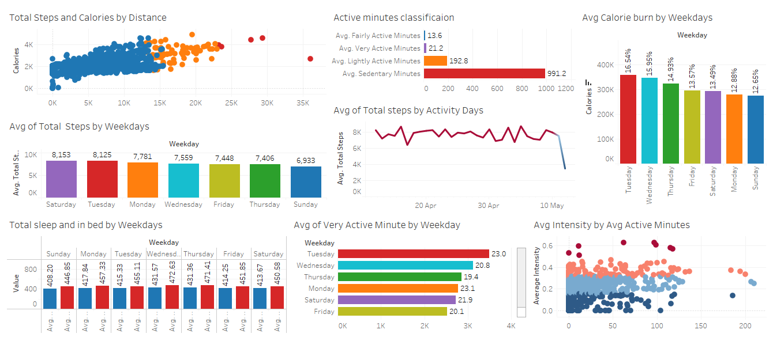


Dashboard
Click Here For Dashboard

Slide 9
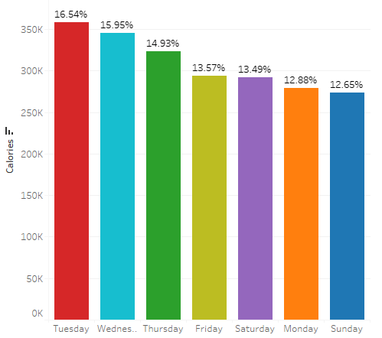
Average Calorie burn by Day of Week
The data shows that Tuesdays is the day with highest average calorie burn, accounting for 16.54%.
On the other hand, Sundays has the lowest average calorie burn at 12.65% of the total.
Weekdays show higher physical activity, while weekends show lower activity.

Slide 10
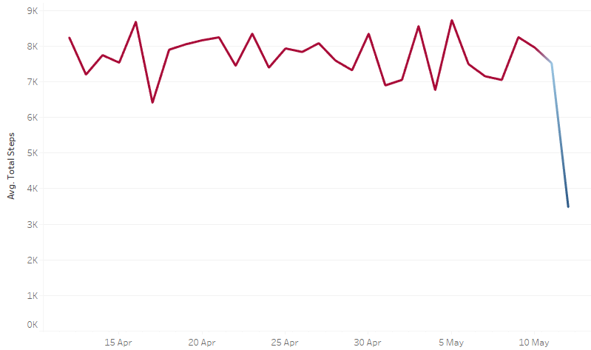
Average Steps Taken From April to May
The data is collected from non-Bellabeat users’ devices from April to May 2016.
Average of Total steps taken declined notably from April to May according to the data analysis.
In April, the average total steps taken were around 8,000, while in May, it was less than 4,000.
This decline of about 50% in average total steps taken may be due to weather changes, personal routines, or other external factors.

Slide 11
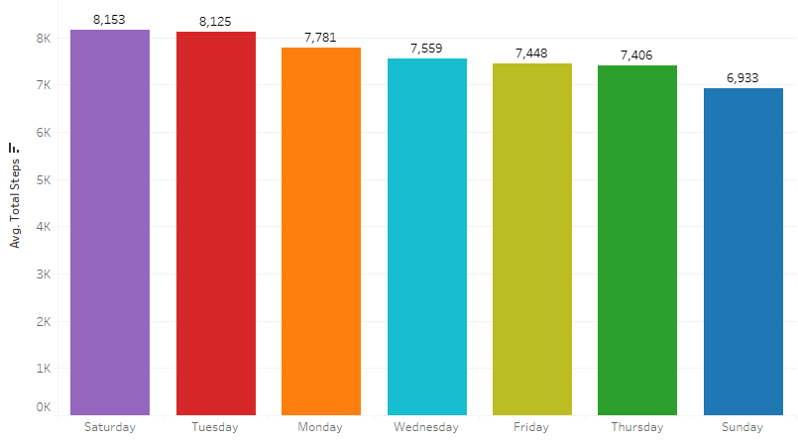
Average Steps Taken by Day of Week
Based on the analysis, the users walked on an average of 8,153 steps on Saturdays.
In contrast, on Sundays, customers took the least number of steps, which was about 6,933.
Weekend days, especially Sundays, show the lowest average step count based on the data.

Slide 12
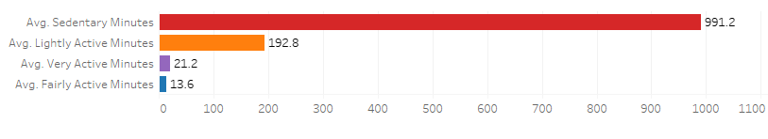
Average Steps Taken by Day of Week
Users were mostly sedentary, spending 991.2 minutes on average in that mode.
Users’ spent an average of only 13.6 minutes in fairly active mode, indicating it was the least frequent behavior observed.
The data underscores the Importance of being active and reducing sedentary time.

Slide 13
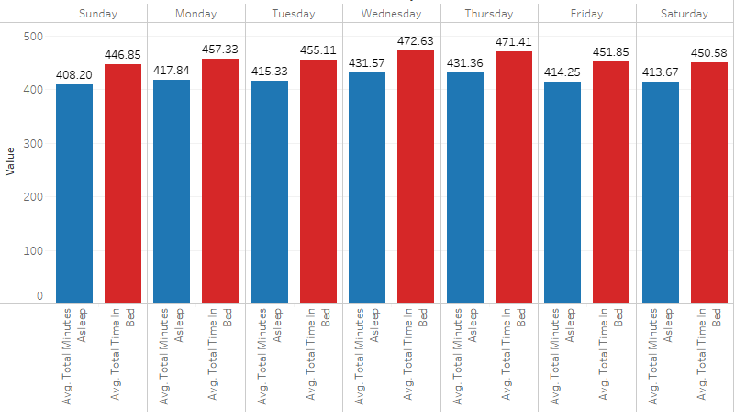
Sleep Duration and Bedtime Patterns
According to the analysis, Users slept longest on Wednesdays (431.7 min) and shortest on Sundays (408.2 min), on average.
Users spent longest time on bed Wednesdays (472.63 min) and shortest time Sundays (446.85 min).
Emphasize quality sleep and consistent bedtime patterns for better health and well-being.

Slide 14
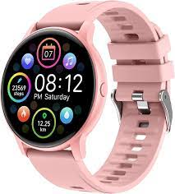
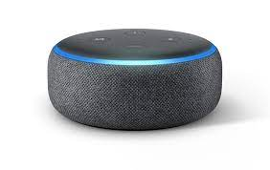
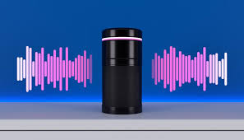
Applying Trends to Bellabeat Customers with Leaf
Voice Assistant
Fitness Tracking
Smart Home
Integration
Bellabeat could incorporate more fitness tracking features into their smart wellness tracker leaf, catering to customers' health needs and lifestyle.
Bellabeat could integrate smart home automation features into leaf for a more seamless and stress-free lifestyle.
Bellabeat could use voice assistants to provide a more hands-free experience for customers seeking a modern and convenient lifestyle.

Slide 15
Marketing Strategy Influence
Targeted Ads
Data on how consumers use non-Bellabeat smart devices can inform Bellabeat's targeted marketing strategies to reach broader audiences.
Product Design
Features informed by consumer insights may give Bellabeat an advantage in the market and appeal to a wider audience.
Brand Messaging
The value proposition of Bellabeat can be expanded to better fit the modern and convenient lifestyle that consumers are seeking with smart devices.
Social Media Campaigns
Bellabeat's marketing can leverage social media platforms to educate target audiences on the functionality and ease of smart devices.

Slide 16
Consumer Behaviour & Preferences
1
Privacy Concerns
While smart devices are popular, many consumers have expressed privacy concerns when it comes to data collection and use.
Design Aesthetics
2
Consumers are now more likely to choose a device that offers competitive features as well as an attractive design.
3
Price
Although feature set and design aesthetics are important, price is an important factor that influences their purchasing decision.

Slide 17
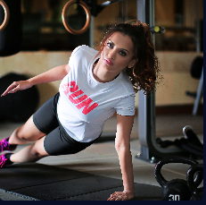


Bridging the Gap
Inclusivity
Demand Generation
Privacy
Privacy concerns can also be addressed through transparent communication and proactive privacy features built into the products.
Bellabeat could form partnerships with fitness influencers to create demand and drive sales of their new and improved fitness-focused smart device.
Bellabeat's marketing campaigns could showcase a workforce that is friendly to women interested in technology to create a sense of inclusion and diversity for their female customers.

Slide 18
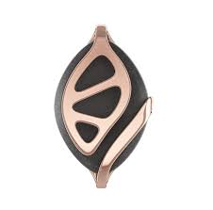
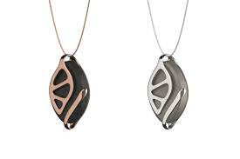
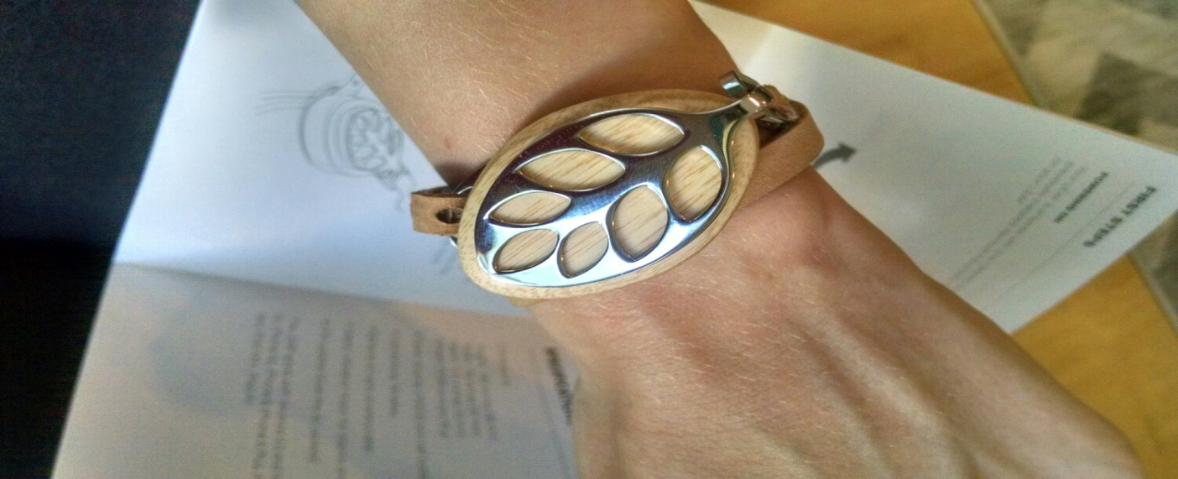
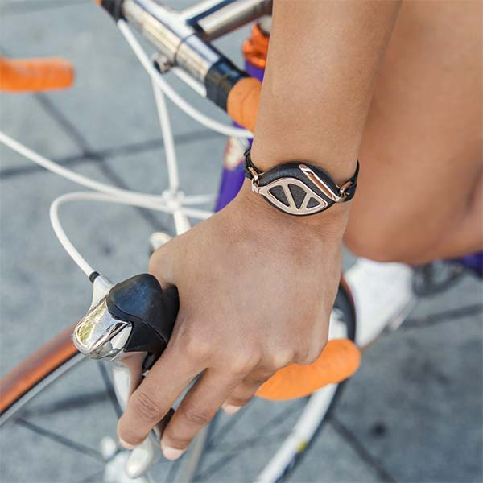
Innovation at Bellabeat : Bellabeat Leaf
Bellabeat is committed to delivering innovative, visually appealing, and functional smart devices for women's health and wellness, designed to meet women's connected health needs in a technology-driven environment and adding the insights gained from the analysis will make it more attractive amongst the target audience.

Slide 19

The Future of Health & Wellness
As the world becomes more technology-driven, it's essential for companies like Bellabeat to stay ahead of the curve to meet the evolving health and wellness needs of their customers, through innovation and customer-focus.

Slide 20

Conclusion
Promote Leaf's monitoring and personalized goals to target fitness enthusiasts and combat declining activity.
Emphasize active time and decrease sedentary behavior to promote healthy habits with Leaf.
Market Leaf's sleep tracking features for improved well-being using sleep pattern data.
Use marketing strategies to increase brand awareness and attract new Leaf users.

Slide 21
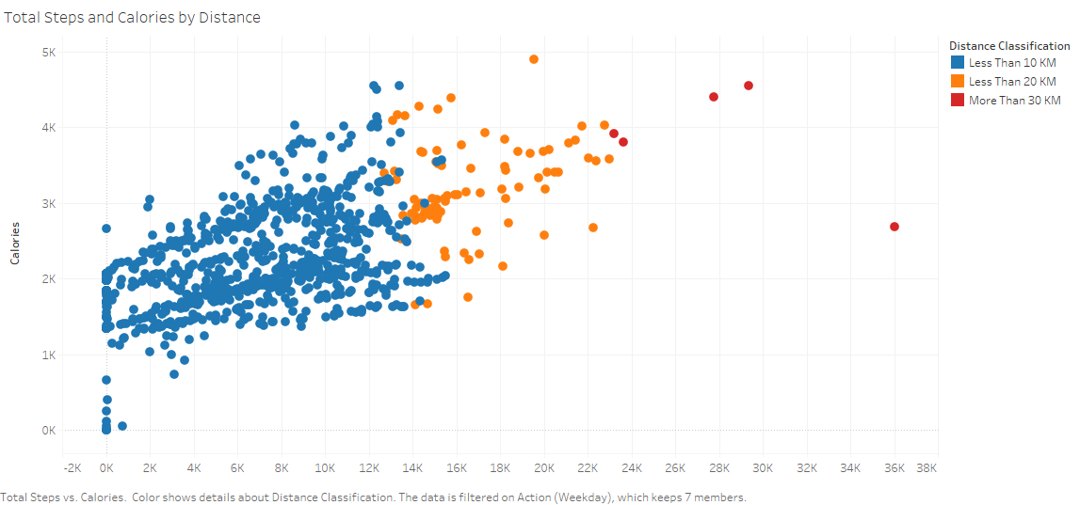

Appendix
Total Steps and Calories by Distance

Slide 22
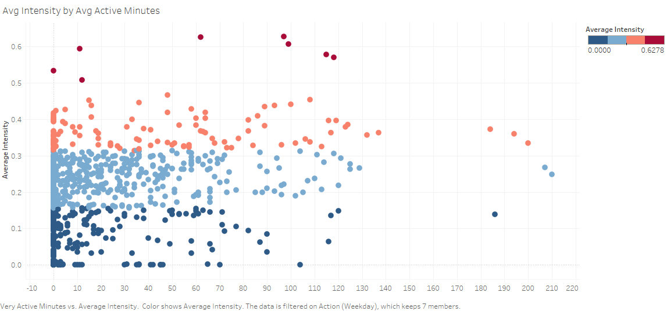
Average Intensity by Average Active Minutes

